Slide 1

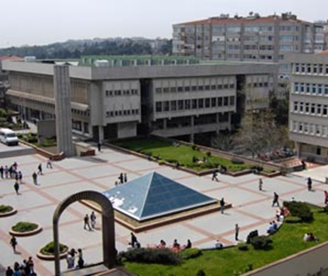
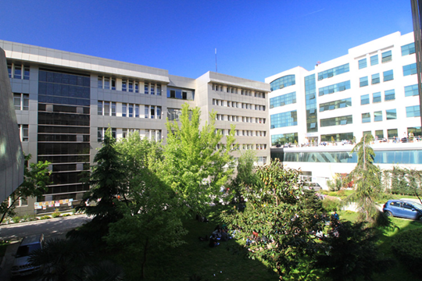

Boğaziçi University
The Department of Foreign Language Education
English Language Education
Graduate Programs
Place Logo Here

Slide 2
History
1984- Undergraduate program
1990- Graduate program
1994- Ph.D. program

Slide 3
Academics
13 Full-time Instructors
  3 Professors
  3 Associate Professors
  6 Assistant Professors
  2 Instructors (PhD)
  6 Research assistants

Slide 4
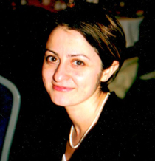
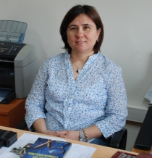
Academics
Prof. Dr. Ayşe GÜREL
Ph.D. McGill University
Research interests:
Second language acquisition
First language attrition
L2 morphological processing
L2 sentence processing
Prof. Dr. Yasemin BAYYURT
Ph.D. Lancester University
Araştırma Alanları:
Sociolinguistics
Language Policies
Corpus Studies
Technology and language education

Slide 5
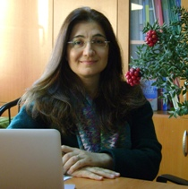
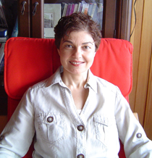
Academics
Prof. Belma HAZNEDAR
Ph.D. , University of Durham
Research interests:
Child language acquisition
Second language acquisition in early childhood
Simultaneous bilingualism
Teaching foreign languages to early learners
Assoc. Prof. Gülcan ERÇETİN
Ph.D. , University of Arizona
Research interests:
Reading and working memory in a second language
Eye movements
Mobile assisted language learning
Language learning in multimedia contexts

Slide 6
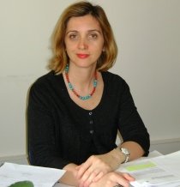
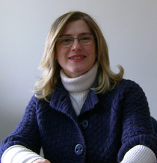
Academics
Assoc. Prof. Sumru AKCAN
Ph.D. , University of Arizona
Research interests:
Second language teaching methods
Teacher education
Distance learning
Billingual education
Assoc. Prof. Leyla MARTI
Ph.D. , Lancaster University
Research interests:
Pragmatics
Sociolinguistics
Conversation analysis
Intercultural communication

Slide 7
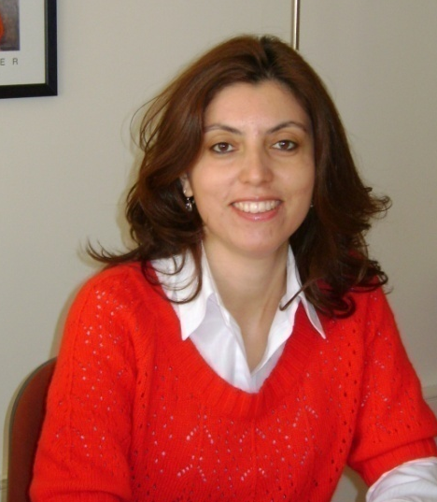
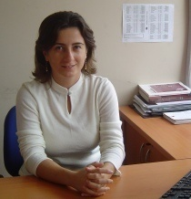
Academics
Asst. Prof. Sibel TATAR
Ph.D. , Indiana University, Bloomington
Research interests:
L2 Testing and evaluation
Teacher education
Foreign language teaching methods
Asst. Prof. Senem YILDIZ
Ph.D. , Indiana University, Bloomington
Research interests:
Computer-assisted language learning
Foreign language teaching methods
Material development and evaluation

Slide 8
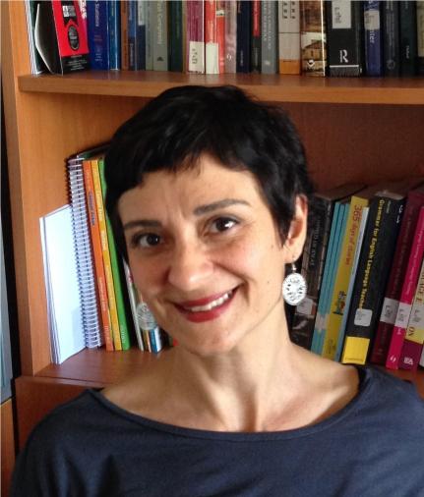
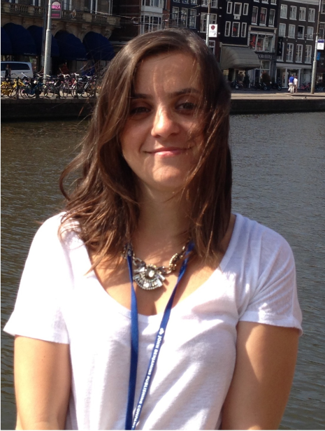
Academics
Asst. Prof. Aylin Ünaldı
Ph.D. , Boğaziçi University & University of Bedfordshire
Research interests:
L2 testing and evaluation
Cognitive processes in reading at text and intertextual levels
Processes underlying L2 academic literacy
Text processing for writing purposes
Asst. Prof. Şebnem Yalçın
Ph.D. , University of Toronto
Research interests:
Instructed second language acquisition (SLA)
Content-based language learning
Individual differences in foreign language learning
Working memory capacity and SLA

Slide 9
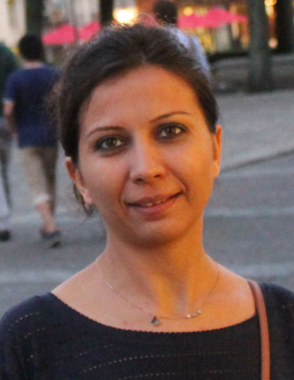
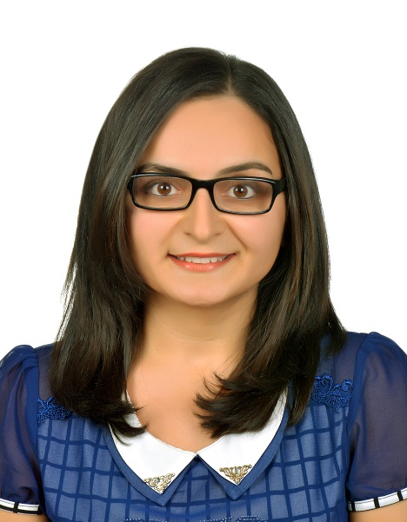
Academics
Asst. Prof. Nazik Dinçtopal-Deniz
Ph.D. , City University of New York
Research interests:
L1 and L2 sentence processing
Prosodic disambiguation in sentence processing
Working memory in sentence processing
Asst. Prof. Nur Yiğitoğlu
Ph.D. , Georgia State University
Research interests:
Teacher education
Teacher cognition
Second language writing

Slide 10
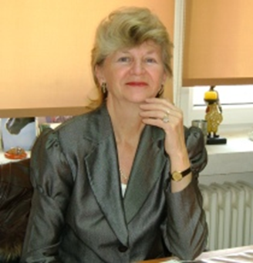
Academics
Dr. Judy Monthie-Doyum
Ph.D. , Université de la Sorbonne Paris
Research interests:
Drama in language education
Literature and foreign language education
Dr. Işıl Erduyan
Ph.D., University of Wisconsin-Madison
Research interests:
Multilingualism and Identity
Language teaching in multilingual classrooms

Slide 11
Research Assistants:
  Sezen Bektaş
  Serhat Kurt
  Yavuz Kurt
  Gizem Mutlu
  Elifcan Öztekin
  Ecehan Sönmez

Slide 12
English Language Education
M.A. Program
Semester 1 |  |  | Semester 2
FLED 501 | Research Methods | 3 | FLED XXX | Area Elective | 3
FLED 511 | Second Language Acquisition | 3 | FLED XXX | Area Elective | 3
FLED XXX | Area elective | 3 | FLED 579 | Seminar | -
– – | Area/Complementary Elective | 3 | FLED XXX | Area Elective | 3
 |  |  | – – | Area/Complementary Elective | 3
 |  | 12 cr. |  |  | 12 cr.

Slide 13
English Language Education
Ph.D. Program
Semester 1 |  |  | Semester 2
FLED 611 | Aspects of Bilingualism | 4 | FLED 602 | Advanced Research Methods | 4
FLED XXX | Area Elective | 4 | FLED XXX | Area Elective | 4
FLED XXX | 689, 691-699 Special Topics in Applied Linguistics | 4 | FLED XXX | Area Elective | 4
– – | Area/Complementary Elective | 3 | – – | Area/Complementary Elective | 3
 |  | 15 cr. |  |  | 15 cr.

Slide 14
A Selection of Electives
FLED 503 Early Bilingualism
FLED 504 Learning Turkish as a Foreign Language
FLED 505 Qualitative Research Design in Language Studies
FLED 506 Use of Corpora in Language Learning
FLED 507 Language and Gender
FLED 512 Sociolinguistic Issues in Second Language Acquisition
FLED 513 Psycholinguistic Issues in Second Language Acquisition
FLED 514 Neurolinguistic Aspects of Bilingualism
FLED 515 Cross-Cultural Communication and Language Education
FLED 543 Educational Technology in English Language Education
FLED 603 Acquisition of Literacy Skills in Bilingual/Multilingual Children
FLED 604 Pedagogical Issues in Turkish as a Foreign Language
FLED 605 World Englishes
FLED 615 Issues in Foreign Language Education Planning
FLED 680-689, 691-699 Special Topics in Applied Linguistics

Slide 15
M.A. Applications
An undergraduate degree diploma or a graduation document.
Those who have not graduated yet (at the time of application) must submit an official letter indicating that they are expected to have graduated by the graduate program registration date.
ALES (EA-Equally-weighted): 70 or GRE-Quant.: 155
B.A GPA: 2.5/4.00 or 65/100
*Language Proficiency: TOEFL (PBT)= 627 + TWE 4.5 or TOEFL (IBT)= 108 + TWE 24
YDS= 90 BUEPT= B
Statement of Purpose
2 Reference letters
(Applicants who have graduated from our university within two years are exempt from these requirement. )
Written exam + Interview
(Multiple-choice Test) (For candidates who pass the written exam)
For more information: http://adaylar.boun.edu.tr/tr-TR/Anasayfa

Slide 16
Ph.D. Applications
M.A. degree in English language education, Applied Linguistics, or a related field.
Those with a degree in other disciplines need to have a teaching certificate or at least two years’ experience in English language education.
An undergraduate degree diploma or a graduation document.
Those who have not graduated yet (at the time of application) must submit an official letter indicating that they are expected to have graduated by the graduate program registration date.
ALES (EA-Equally-weighted): 70 or GRE-Quant.: 155
B.A. GPA: 2.5/4.00 or 65/100
*Language Proficiency: TOEFL (PBT)= 627 + TWE 4.5 or TOEFL (IBT)= 108 + TWE 24; YDS= 90 BUEPT= B
Statement of Purpose
*2 Reference letters
(Applicants who have graduated from our university within two years are exempt from these requirement. )
Written exam + Interview
(Test+Essay) (For candidates who pass the written exam)
For more information: http://adaylar.boun.edu.tr/tr-TR/Anasayfa

Slide 17
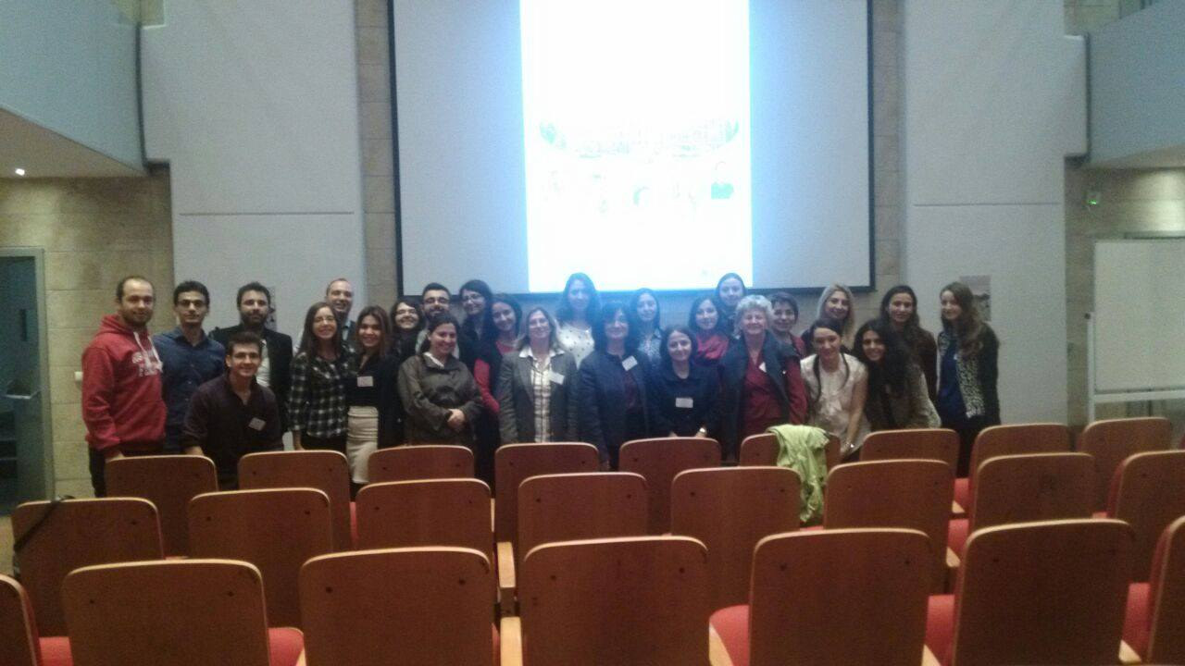
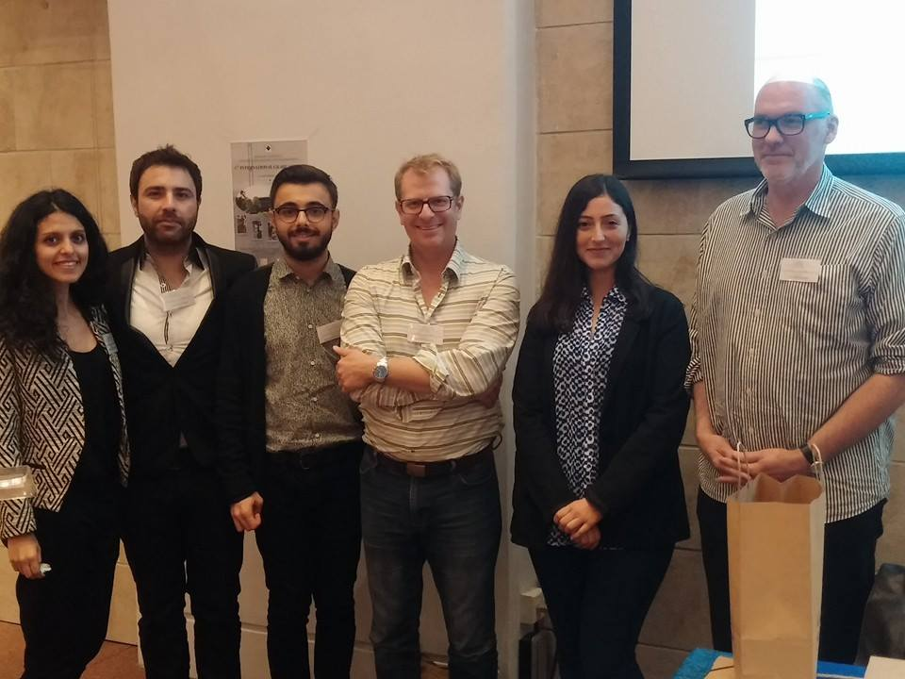
Student Profile
English teacher
English instructor
Research assistant

Slide 18
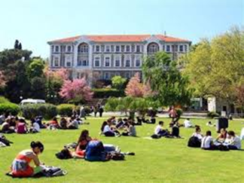
Statistics
Students and Graduates (2016)
Mean Completion Time
Program | Students (n) | Graduates (n)
M.A. | 37 | 81
Ph.D. | 25 | 11
Program | Completion Time
M.A. | 4 semesters (max. 6 semesters)
Ph.D. | 8 semesters (max. 12 semesters)

Slide 19
Recent theses
M.A. THESES
Fatma Küçük, 2016, Assessing Academic Writing Skills in Turkish as a Foreign Language.
Emel Tozlu, 2016, Development of a Listening Test for Learners of Turkish as a Foreign Language
Elifcan Öztekin, 2016., Metacognitive Awareness of Listening Strategies in L2 English and L3 Italian
Zeynep Sena Abaylı, 2016. , Decomposability and Transparency: A Corpus-Based Analysis of the Use of Phrasal Verbs in ELF Interactions
Selahattin Yılmaz, 2016. A Corpus-Based Investigation of the Effect of Nativeness and Expertise on Reporting Practices in Academic Writing.
Sinem Aydoğan, 2016. Task Orientation and Vocabulary Knowledge Types: How Do They Relate to Collocational Knowledge?
Merve Celen, Program evaluation of an English language teacher education practicum: Insights from supervisors, student teachers, and graduates.
Hande Karakaplan, 2015. The effects of priming in the production of L2 morphology.
Ecehan Sönmez, 2015, An investigation of spelling skills in Turkish: The role of phonological encoding and rapid naming in the literacy skills of third and fourth graders
Talip Gülle, 2015. Development of a speaking test for second language learners of Turkish.
Yavuz Kurt, 2015. Development of a reading test for second language learners of Turkish.
Didem Tuğçe Erdem, 2015, Comparing L2 learners’ strategy use in literal vs. inferential reading: A cognitive validity study through eye-tracking
Çağla Nikbay, 2014, An exploratory study of progressive '-ing' in a Turkish academic context from the ELF perspective
Beyza Karadallı Sümer, 2014. Scene Setting and Modality Introduction in Sign and Spoken Languages
Nur Başak Karataş, 2013, The effects of captioning on text recall and cognitive load in audio- vs. video-based L2 listening: Offline and online evidence from a mobile-assisted language learning study
Saadet Tıkaç, 2013. Hedging in academic writing: The use of “can” in university students’ argumentative essays at an English medium university in Turkey.
Duygu Çandarlı, 2013. Writer visibility and reader engagement in university students’ argumentative essays
Hatice Özata, 2013, Reading acquisition in early bilingualism: Reading skills of Turkish child L2 learners of English,
Emine Merdin, 2013. Refusing invitations via email: Strategy use in Turkish and American-English refusals

Slide 20
Recent theses
PH.D. THESES
Zeynep Mine Derince, 2016 , An Odyssey of Discovery: Critical Literacy in an English Preparatory Class
Filiz Rızaoğlu, 2016, Second Language Processing of English Past Tense Morphology
Sevdeğer Çeçen, 2015, Interrelationships among L2 linguistic knowledge, working memory functions, and L2 reading
Derya Aktınmakas, 2015. Dynamic interaction of factors influencing Turkish university students’ academic writing practices in English.
Pınar Ersin, 2015, A case study of a Turkish English learner in an EFL setting: investment, imagined community and identity
Fidel Çakmak, 2014, Effects of multimodal glosses on listening comprehension and incidental vocabulary learning of EFL students in a mobile learning environment.
Hande Serdar, 2012, Exploring the interplay between a non-native English language teacher’s pedagogical beliefs, classroom practices and her students’ learning experiences regarding L2 grammar
Oya Özemir, 2012. Reading span tests as predictors of L2 reading comprehension: Investigating differences in task design and assessment through correlational and eye tracking data
Filiz Çele, 2010, Processing wh-dependencies in L2 English: The role of L1 and working memory capacity

Slide 21
Exchange Programs
Department Agreements
  California State University (Sacramento, US)
  Georgia State University (US)
  Universidad de Lleida (Spain)
  Universidad de Valencia (Spain)
  University of Cyprus (Cyprus)
  Fontys University of Applied Sciences (Netherlands)
  Padagogische Hochschule Ludwigsburg (Germany)
  Universitat Augsburg (Germany)
  University of Bremen (Germany) (Only M.A).
  Chemnitz University of Technology (Germany)
  Universitat Erfurt (Germany)
  Universita degli Studi di Verona (Italy)
  Università di Padova (Italy)
  Università per Stranieri di Siena (Italy) (Only M.A).
  Uniwersyet Szczecinski (Poland) (Only M.A).
Faculty Agreements
  Bergische Universitat Wuppertal (Germany)
  Rotterdam University of Applied Sciences (Only M.A.)
  University of Huelva (Spain)
  University of London (UK)
Some of the University Agreements
  Boston University (US)
  University of Alberta (Canada)
  University of York (Canada)

Slide 22
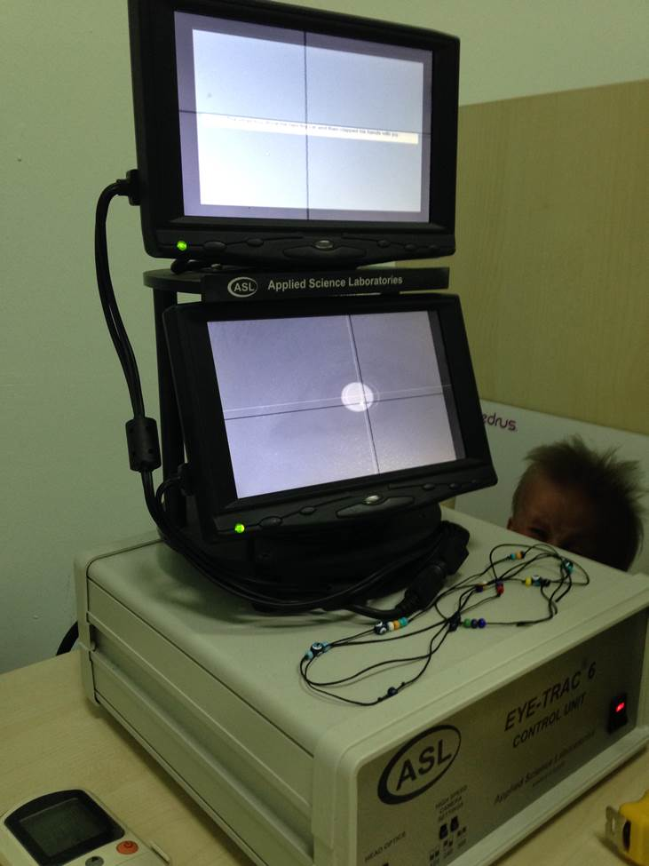
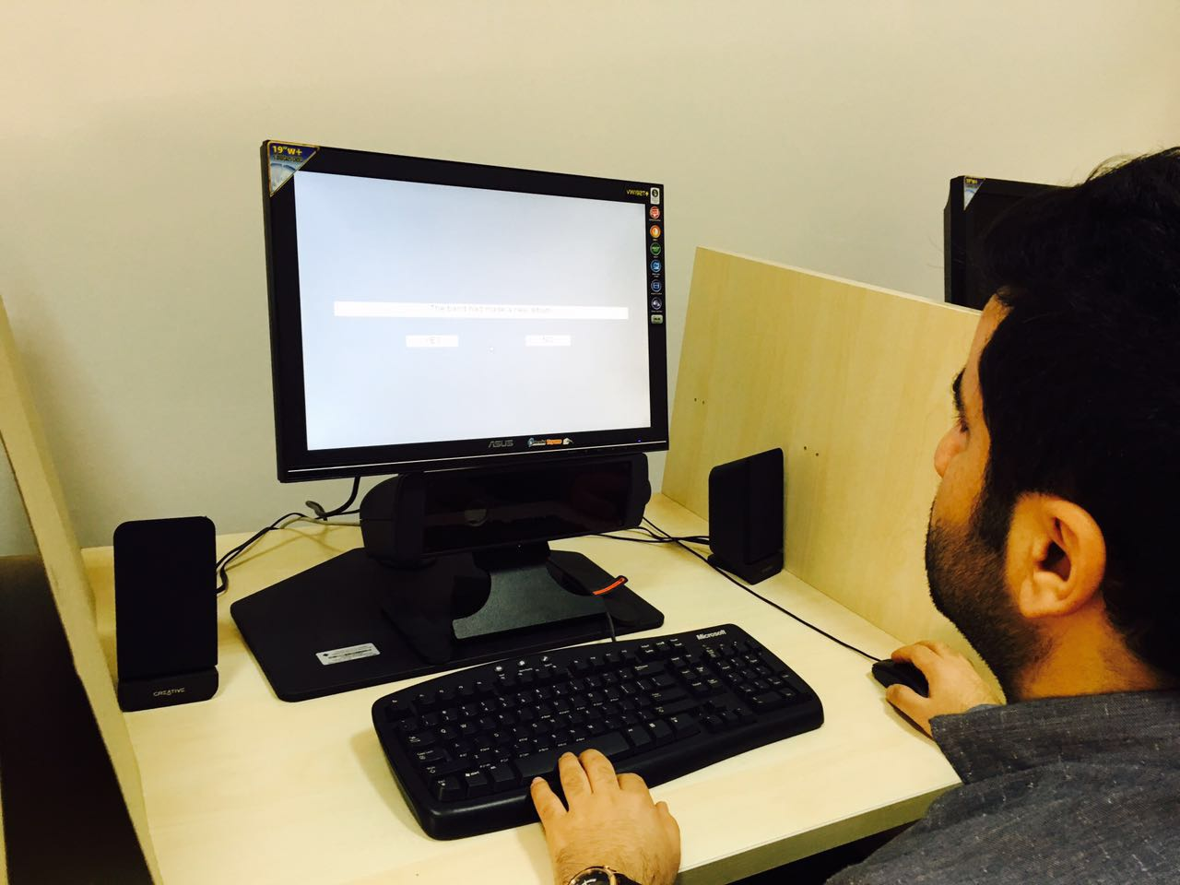
Research Facilities
Department Library, Abdullah Kuran Library
Computer Laboratory (Capacity: 25 people)
- Analysis Software: SPSS, Nvivo
Prof. Dr. Cem Alptekin Eye Tracking Laboratory
  Experimental Software: E-prime, Superlab, Paradigm, ASL Results
  Eye trackers: ASL D6 (60 Hz)
  Eyelink 1000 Plus

Slide 23
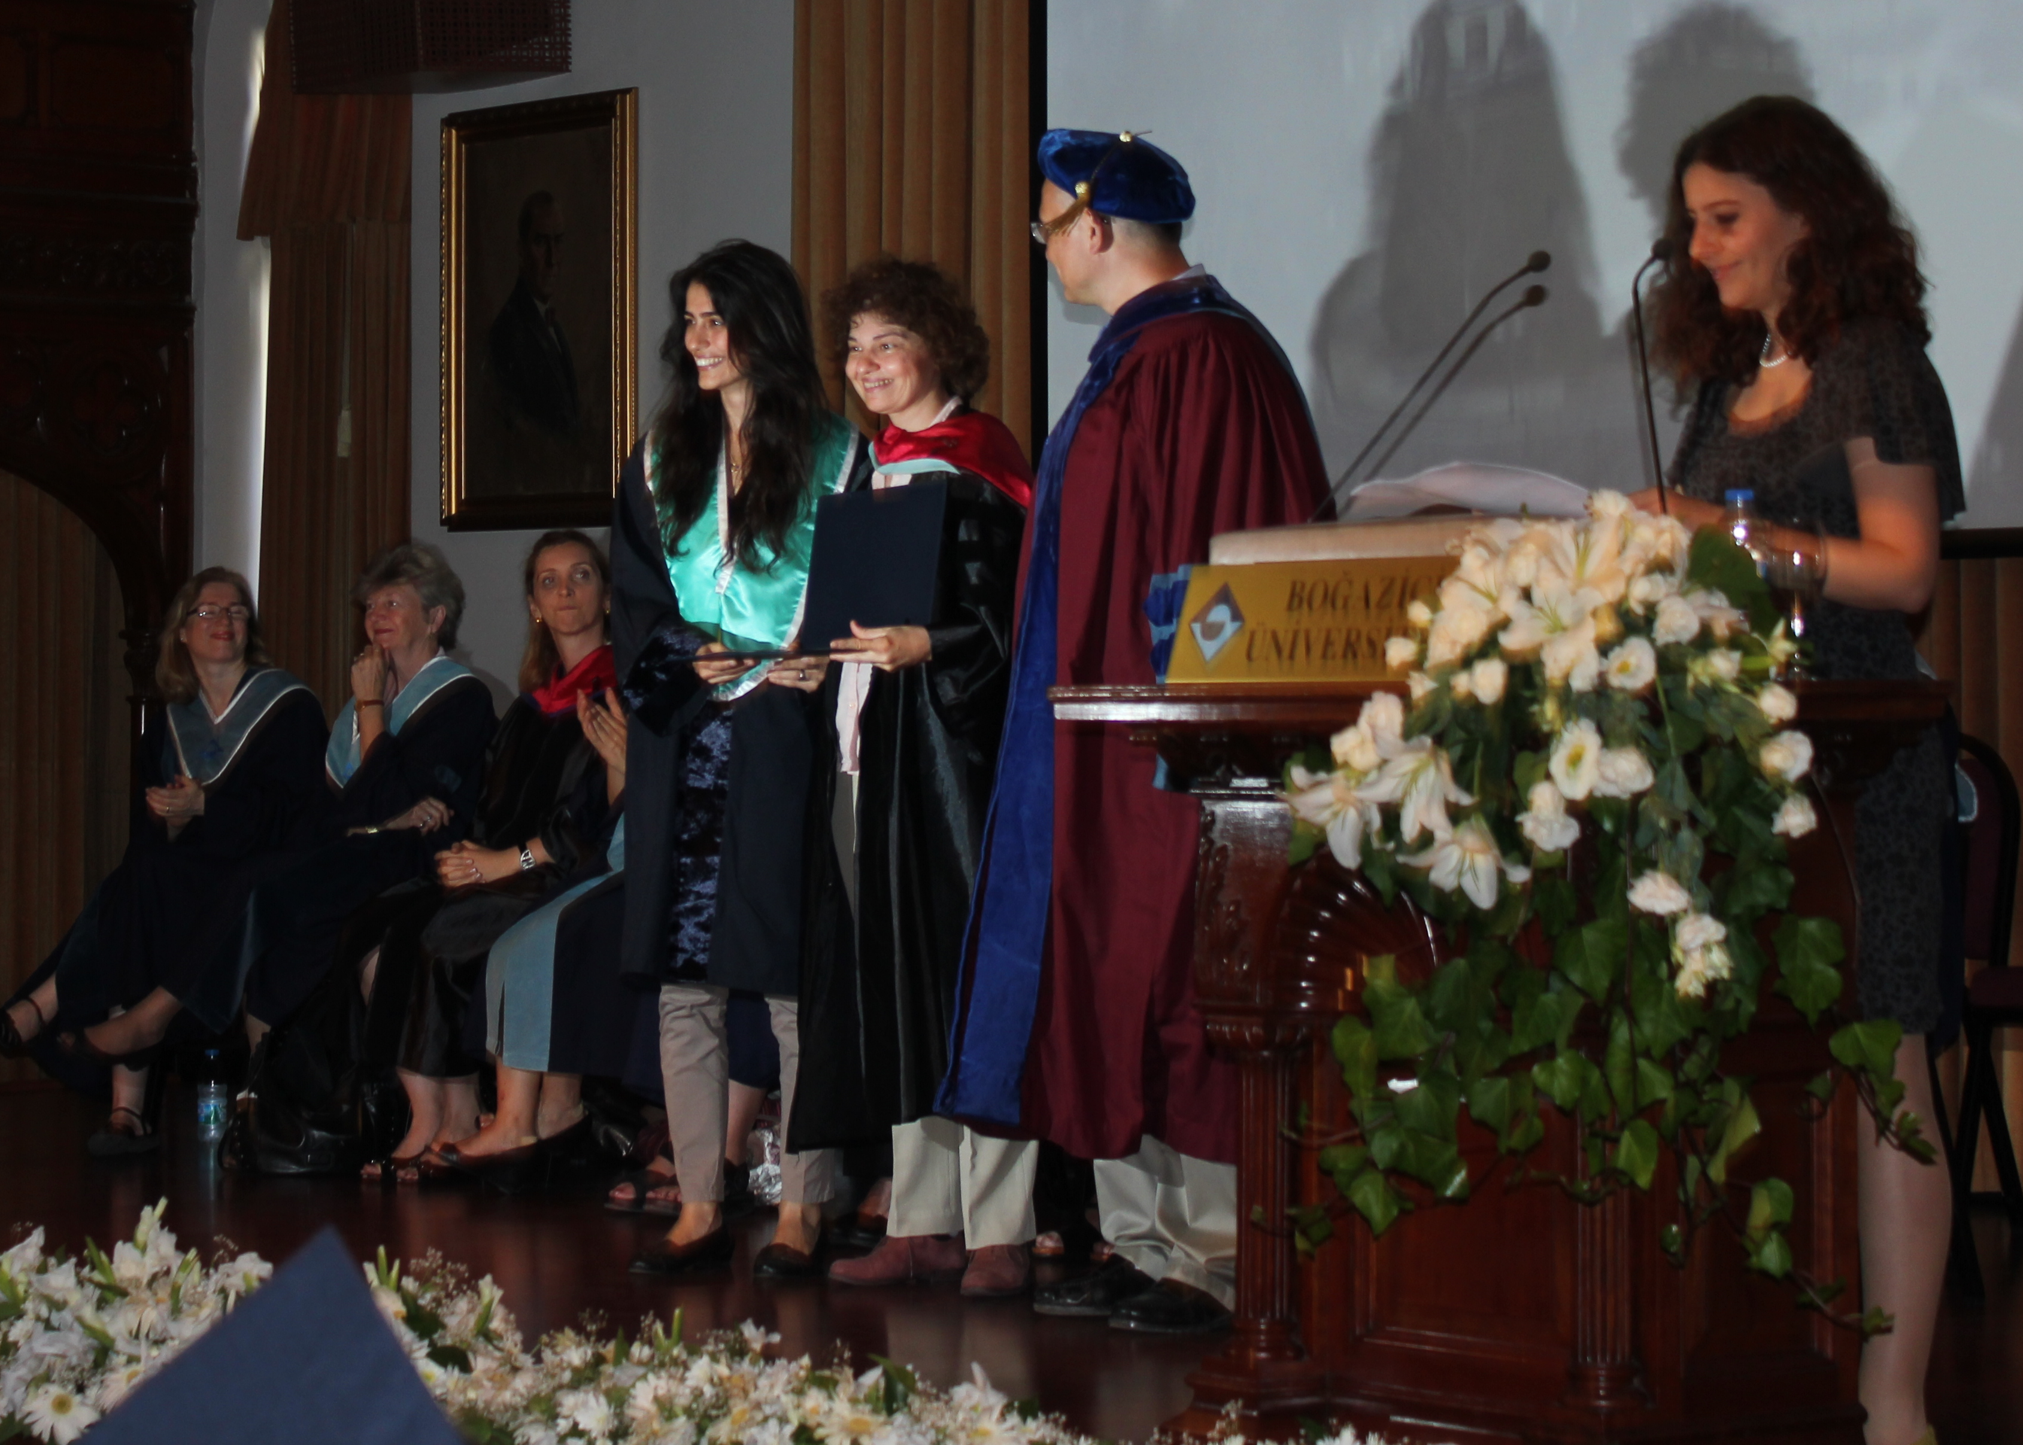
Grants
Faculty Grant
Institute of Social Sciences Grant
BUVAK Grant
BÜMED Grant
TÜBİTAK, BAP Projects
ÖYP
Awards

Slide 24
Recent Projects
Morphological Processing in a Foreign Language: The Cases of Turkish and English, Ayşe Gürel, TÜBİTAK Project, (2012-2015)
Identity Construction in Foreign Language Learning (Yabancı dil öğreniminde yapılandırması), BAP Project, Yasemin Bayyurt, (2011-2015)
European Union, Education and Youth Center, Lifelong Learning Programme, Leonardo da Vinci Transfer of Innovation Project: M-LARG: “M-Learning for the young people (students) at risk groups”, Yasemin Bayyurt, (2009-2012)
TÖDİL Projesi: Tek dilli ve ikidilli çocuklarda Özgün dil bozukluklarının
değerlendirilmesi (Assessment of specific language impairment in monolingual and bilingual children ). TÜBİTAK Project, Belma Haznedar, (2009-2012)
A corpus-based meta-pragmatic analysis of academic writing in an EFL context (Akademik metinlerde üstsöylem (metadiscourse) ögelerine edimbilimsel bir bakış), BAP Project, Yasemin Bayyurt (2010-2013)

Slide 25
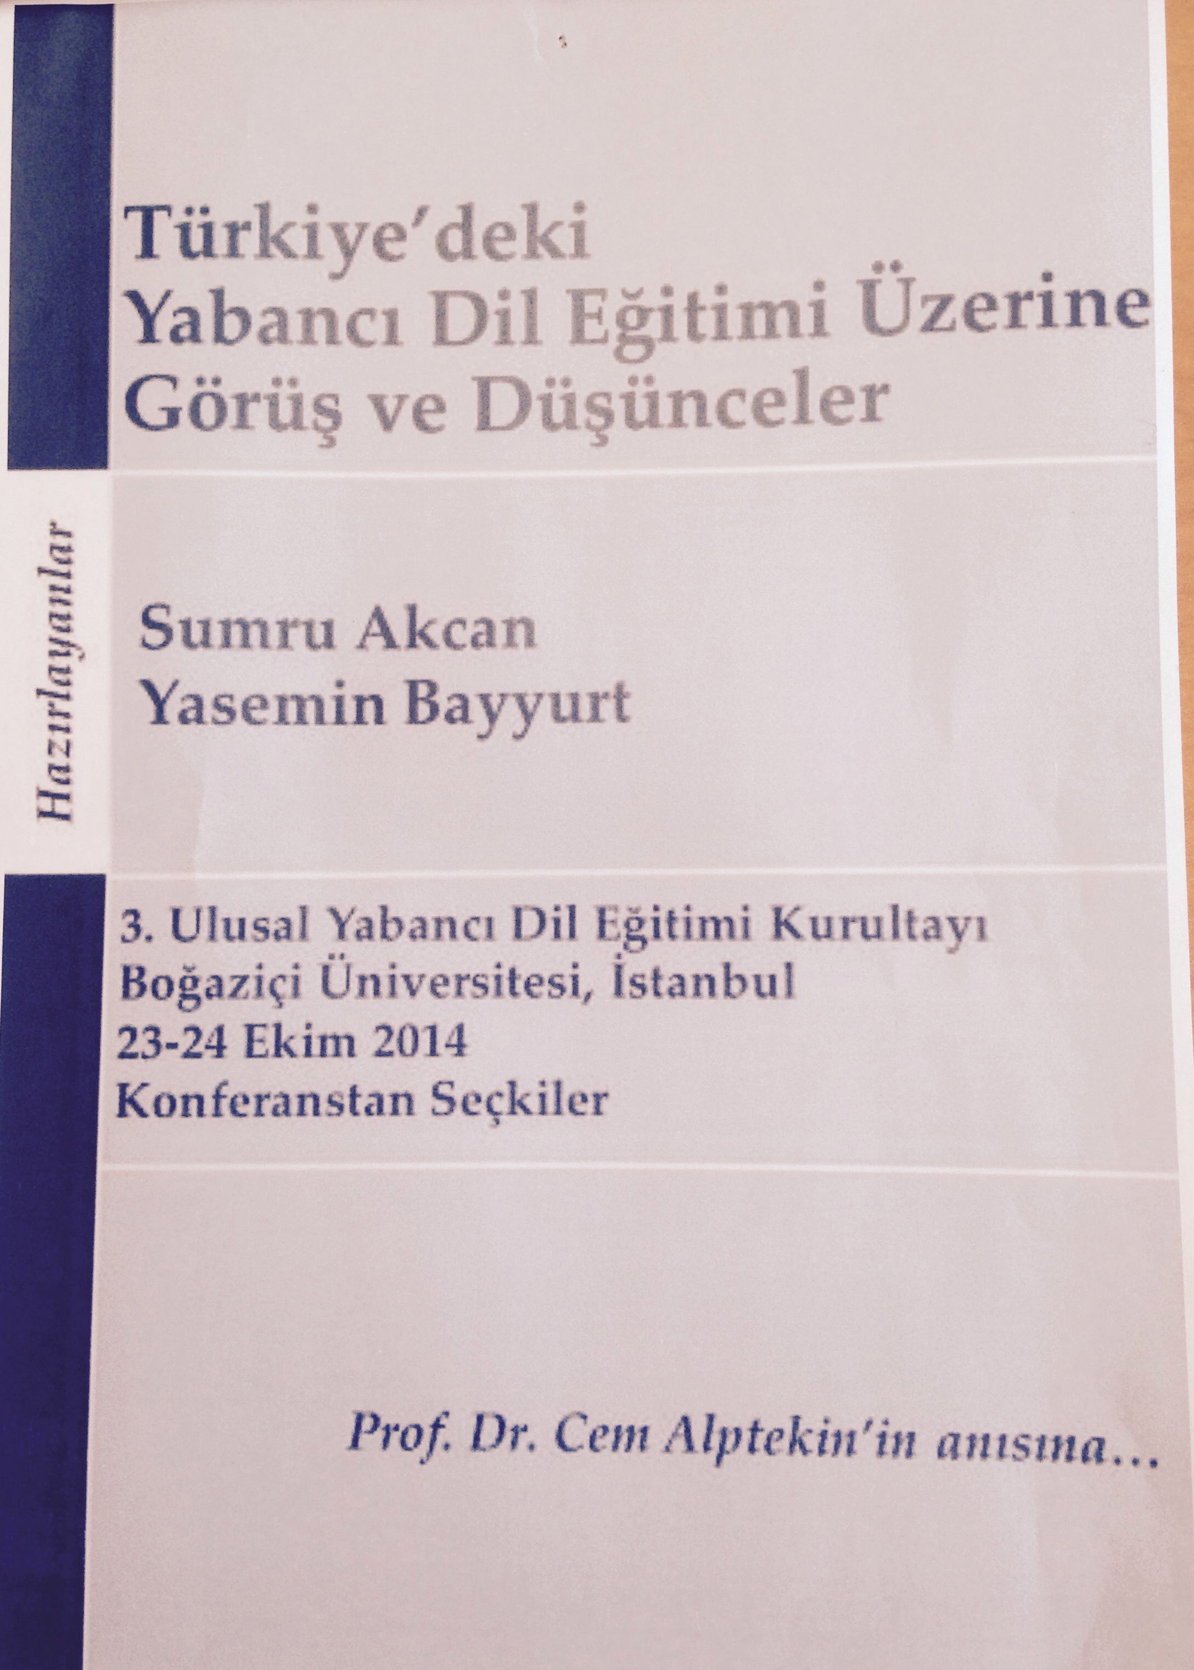
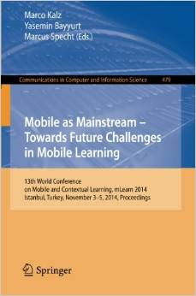
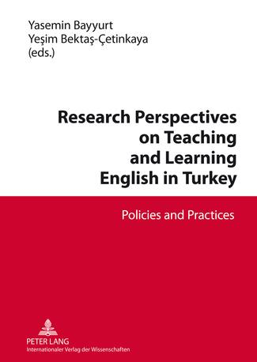
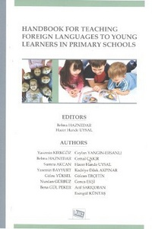
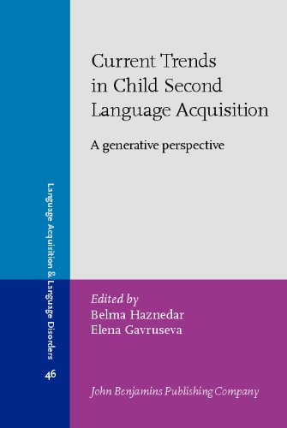

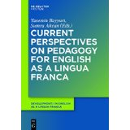
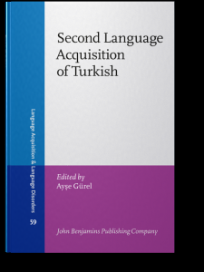

Publications

Slide 26


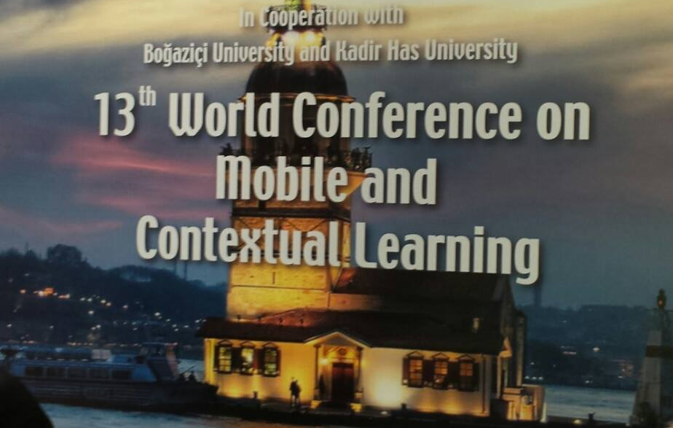



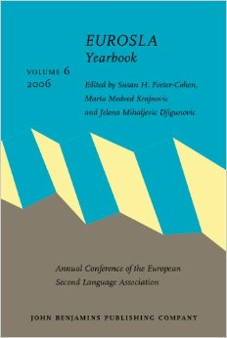

Selection of Recent Conferences

Slide 27
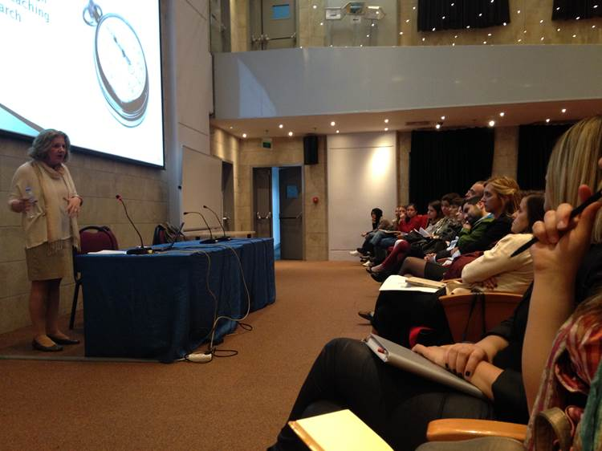
A Selection of Recent Talks
Alister Cumming, Connecting Writing and Reading Assessments to Language Teaching and Learning: Distinguishing Alternative Purposes
Nina Spada - Exploring the Contributions of Instruction to Different Types of L2 Knowledge
Robert DeKeyser - The Elusive Construct of Implicit Second Language Knowledge: Measurements and Alternatives
Enric Llurda, English and Linguistic Diversity in the European Higher Education Area
Fred Genesee, Teaching and Learning in Bilingual Programs: Lessons from Canadian Research
Michael T. Ullman, A Multidisciplinary Investigation of the Neurocognition of First and Second Language
Lydia White, L2 Pronoun Interpretation, Problems of Interpretation or Representation?
Barış Korkmaz, The Neurobiological Foundations of Reading
Mustafa Polat, Emerging Technologies in Language Pedagogy: Language Learners’ Perceptions through the Lenses of Innovation Diffusion and User Intention Theories
Lisya Seloni & Yusuf Sarfati, (Trans)national language ideologies and family language practices: A life history inquiry of Judeo-Spanish in Turkey
Carolina Spiegel, Language change in 21st century Judeo-Spanish in Turkey.
Jack Wendel, Linguistic Landscapes of Istanbul.
Gülsen Yılmaz, First language attrition, bilingualism and biculturalism

Slide 28
What do our MA/PhD graduates do?
Just a few names among many successful professionals:
Nur Başak Karataş, M.A., 2013, Ph.D. Student, University of Maryland, Second Language Acquisition
Hatice Özata, M.A., 2013, Ph.D. Student, Boğaziçi University
Ebru Bağ, M.A., 2009, Ph.D. Student, Toronto University, Ontario Institute for Studies in Education
Sevdeğer Çeçen, Ph.D., 2012, Instructor, Bilgi University, Foreign Language Education Department
Filiz Çele, Ph.D., 2010, Assistant Professor, Aydın University, English Language and Literature Department

Slide 29
Frequently Asked Questions
Course hours, days
Advisor and thesis topic selection
Ph.D. comprehensive exam
Foreign students
Special student degree

Slide 30
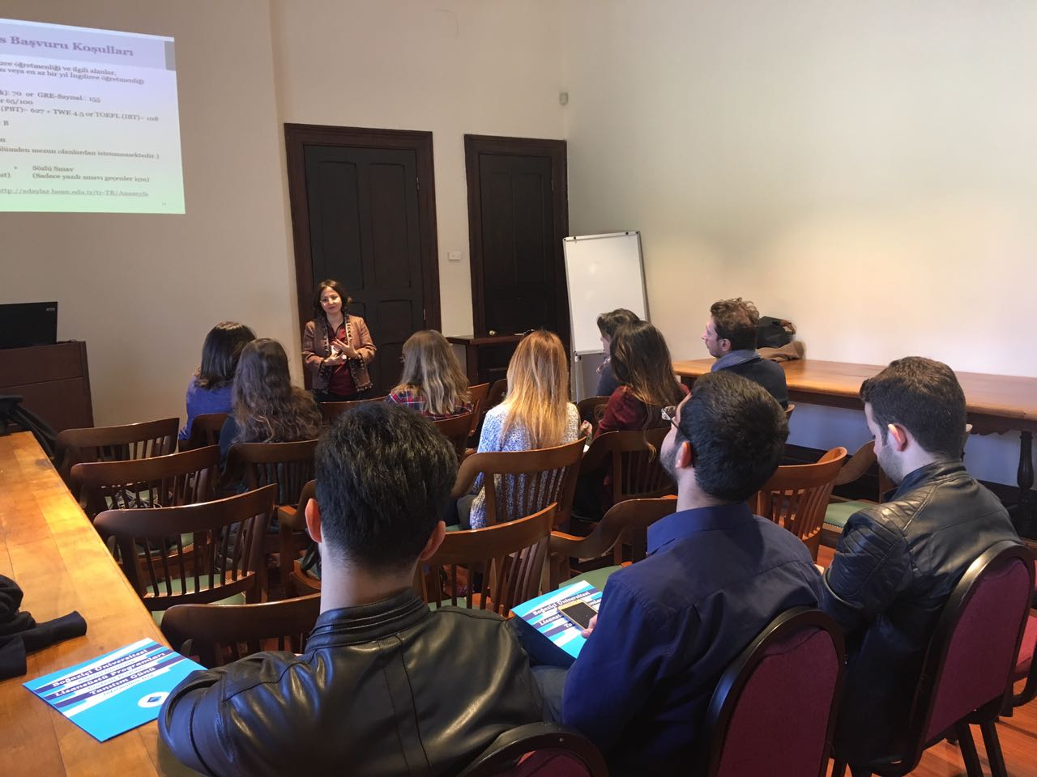

Slide 31
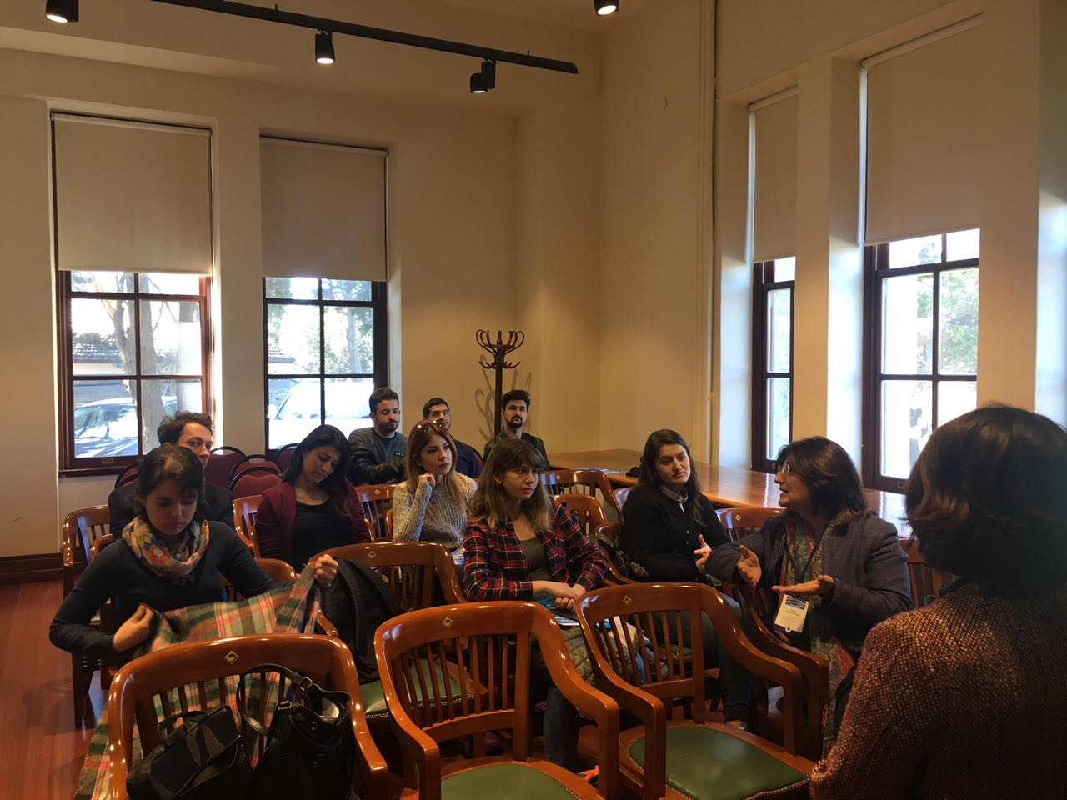

Slide 32
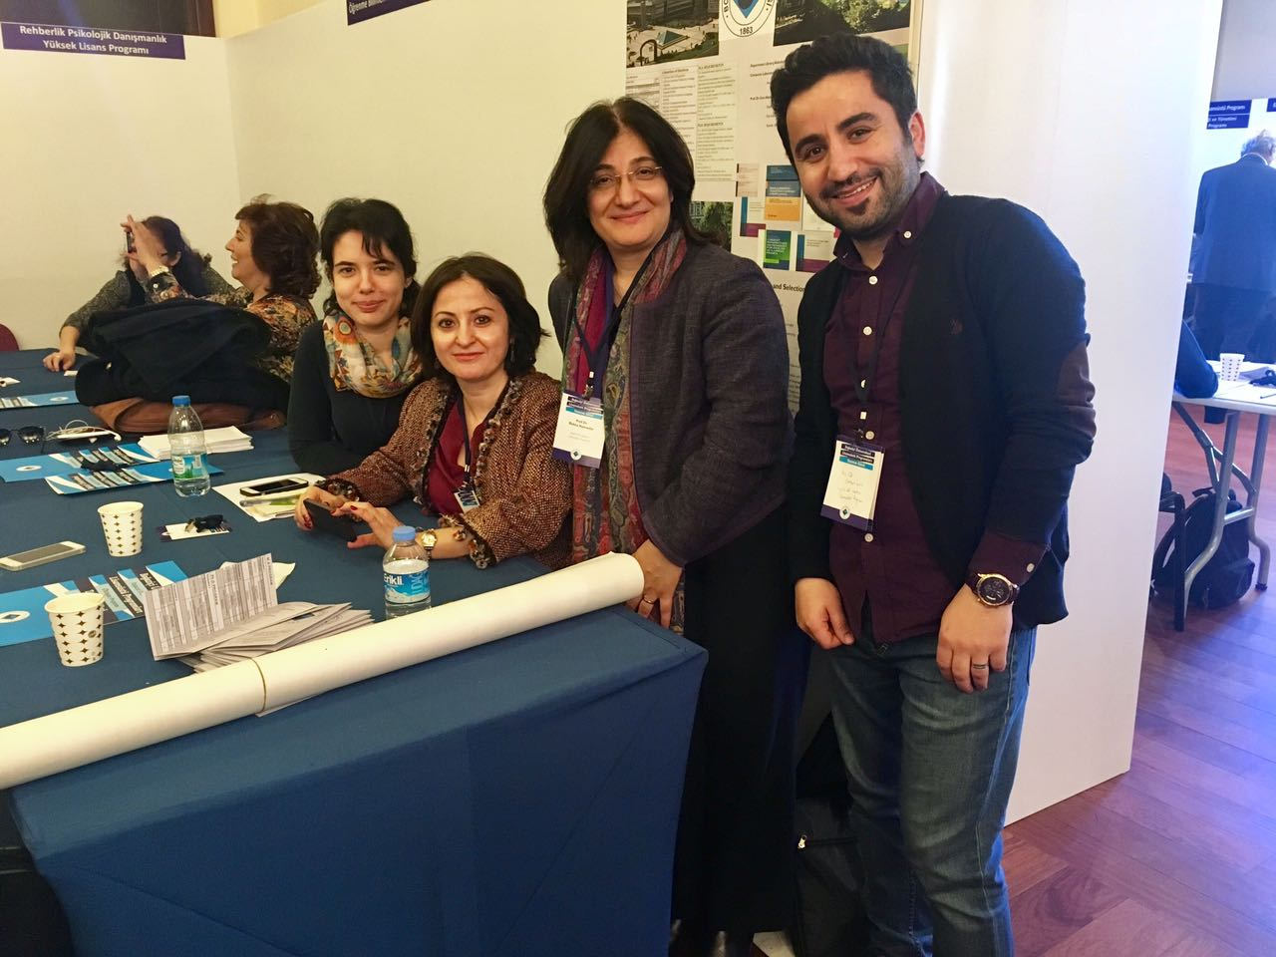

Slide 33
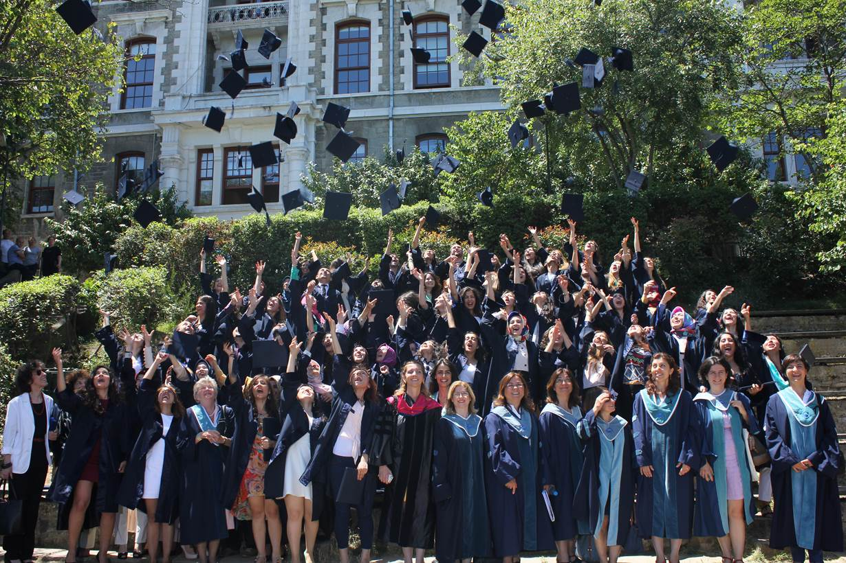
For more information: fled.boun.edu.tr
Thank you!

